Slide 1
Visit with us
By
Ofure Sylvia Ugbesia

Slide 2


BACKGROUND
Visit with us is a tourist and travel company now planning to launch a new product i.e. Wellness Tourism Package. Wellness Tourism is defined as Travel that allows the traveler to maintain, enhance or kick-start a healthy lifestyle, and support or increase one's sense of well-being.
One of the ways to expand the customer base is to introduce a new offering of packages.
Currently, there are 5 types of packages the company is offering - Basic, Standard, Deluxe, Super Deluxe, King. Looking at the data of the last year, we observed that 18% of the customers purchased the packages.

Slide 3
OBJECTIVE
Analyze the customers' data and information
Provide recommendations to the Policy Maker and Marketing Team
Build a model to predict the potential customer who is going to purchase the newly introduced travel package.

Slide 4
Data Dictionary
Customer details:
CustomerID: Unique customer ID
ProdTaken: Whether the customer has purchased a package or not (0: No, 1: Yes)
Age: Age of customer
TypeofContact: How customer was contacted (Company Invited or Self Inquiry)
CityTier: City tier depends on the development of a city, population, facilities, and living standards the categories are ordered i.e. Tier 1 > Tier 2 > Tier 3
Occupation: Occupation of customer
Gender: Gender of customer
NumberOfPersonVisiting: Total number of persons planning to take the trip with the customer
PreferredPropertyStar: Preferred hotel property rating by customer
MaritalStatus: Marital status of customer
NumberOfTrips: Average number of trips in a year by customer
Passport: The customer has a passport or not (0: No, 1: Yes)
OwnCar: Whether the customers own a car or not (0: No, 1: Yes)
NumberOfChildrenVisiting: Total number of children with age less than 5 planning to take the trip with the customer
Designation: Designation of the customer in the current organization
MonthlyIncome: Gross monthly income of the customer
PitchSatisfactionScore: Sales pitch satisfaction score
ProductPitched: Product pitched by the salesperson
NumberOfFollowups: Total number of follow-ups has been done by the salesperson after the sales pitch
DurationOfPitch: Duration of the pitch by a salesperson to the customer.

Slide 5
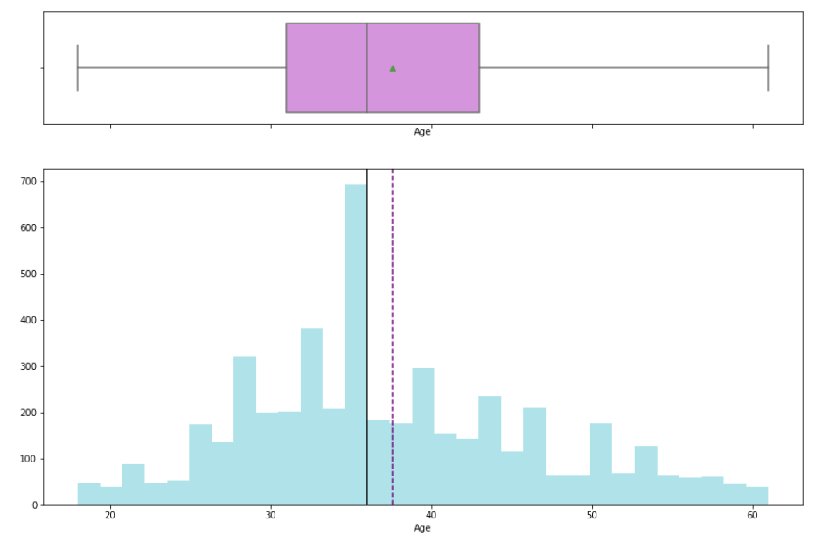
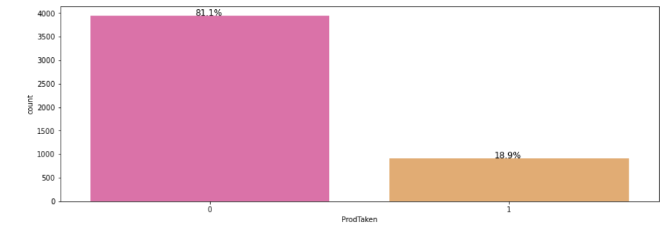
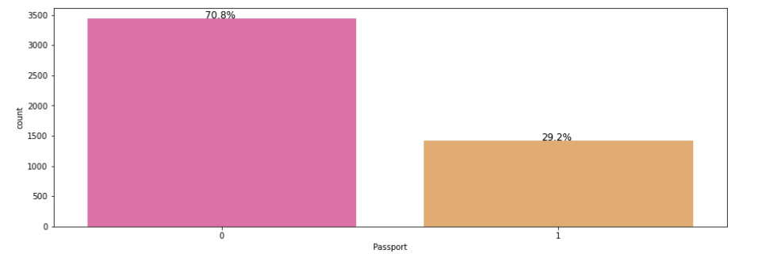
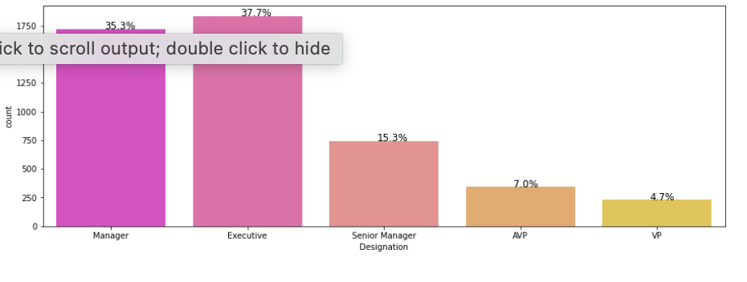
EXPLORATORY DATA ANALYSIS
UNIVARIANCE ANALYSIS ON MOST IMPORTABT VARIABLES
OBSERVATION: Age
Average age of customers is 36 years old
OBSERVATION: ProdTaken
81% of the customers are not purchasing for the new tourism package.
19% are purchasing the new tourism package
OBSERVATION: Passport
1. A higher percentage of 71% of the organization do not have passport
OBSERVATION: Designation
Managers and Executives are the highest job designation who book holidays.

Slide 6
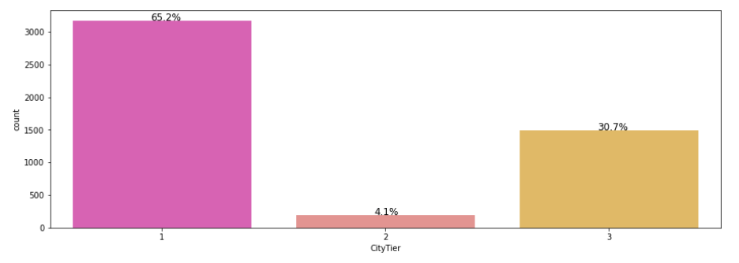
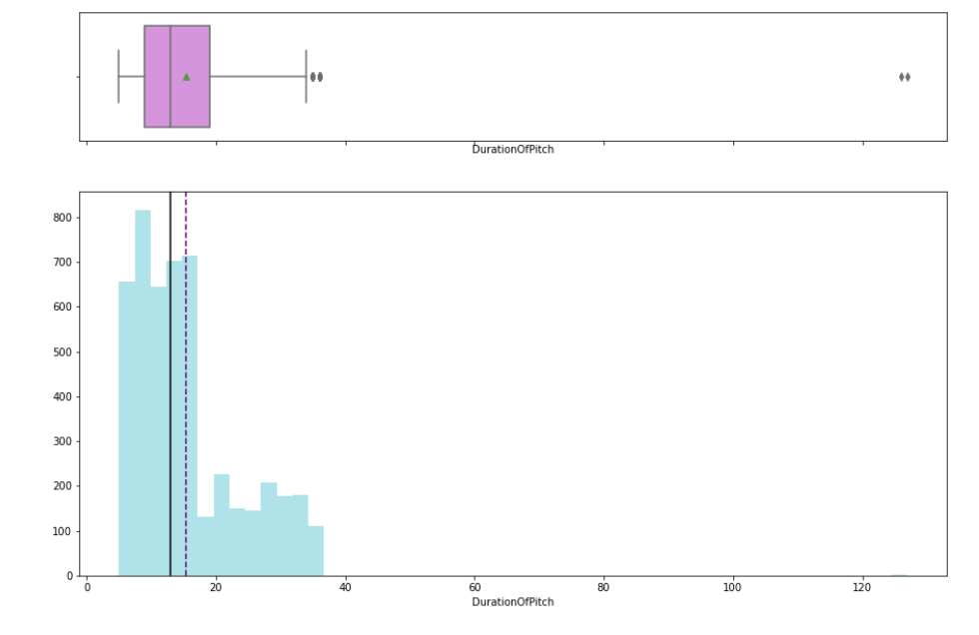
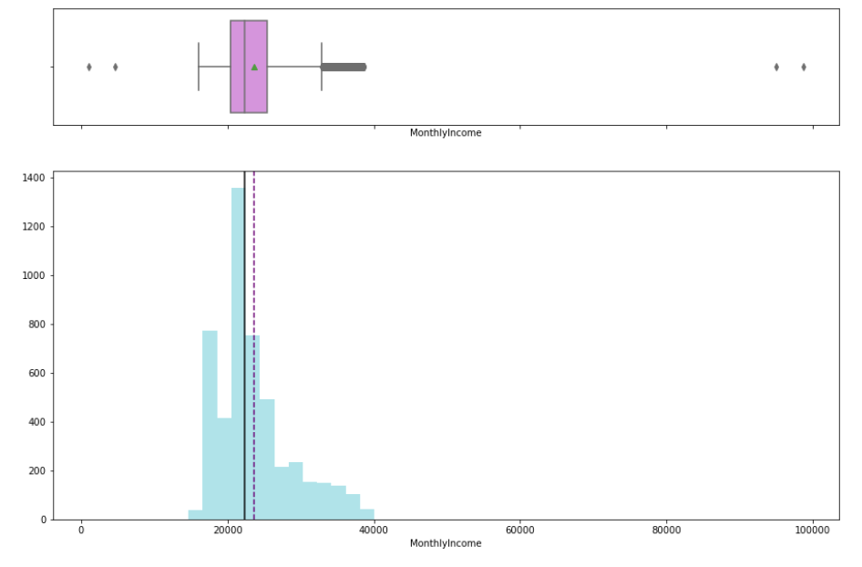
EXPLORATORY DATA ANALYSIS
OBSERVATION: City Tiers
Tier 1 cities have the highest booking for hoilidays
OBSERVATION: Duration of pitch
Duration of pitch is skewed to the left
It takes an average 11minutes to pitch a customer to buy a travel package
OBSERVATION: Monthly Income
1. Most customers earn an average of 23,000
2. Few customer earn between 90,000-100,000 which are the outliers

Slide 7
BIVARIANCE ANALYSIS
WE WILL BE LOOKING AT THE IMPORTANT INDEPENDENT VARIABLES TO PREDICT WHICH CUSTOMERS WILL TAKE PRODUCT TAKEN WHICH IS THE NEW WELLNESS TRAVEL PACKAGE WHICH IS THE DEPENDENT VARIABLE

Slide 8
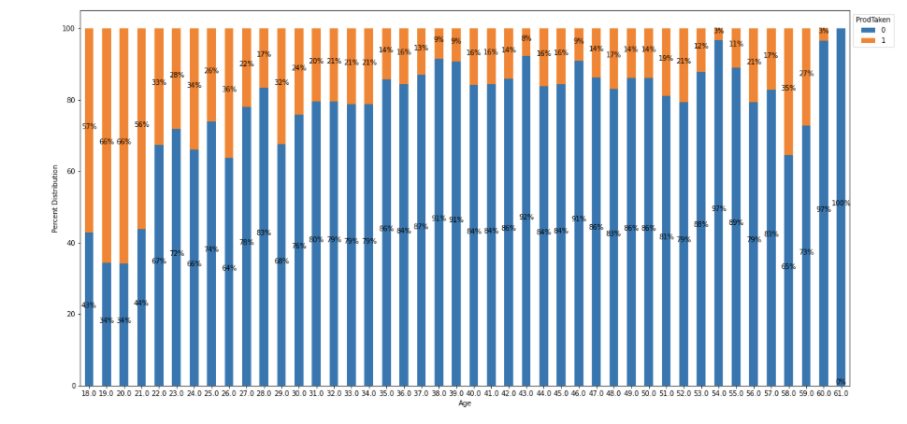
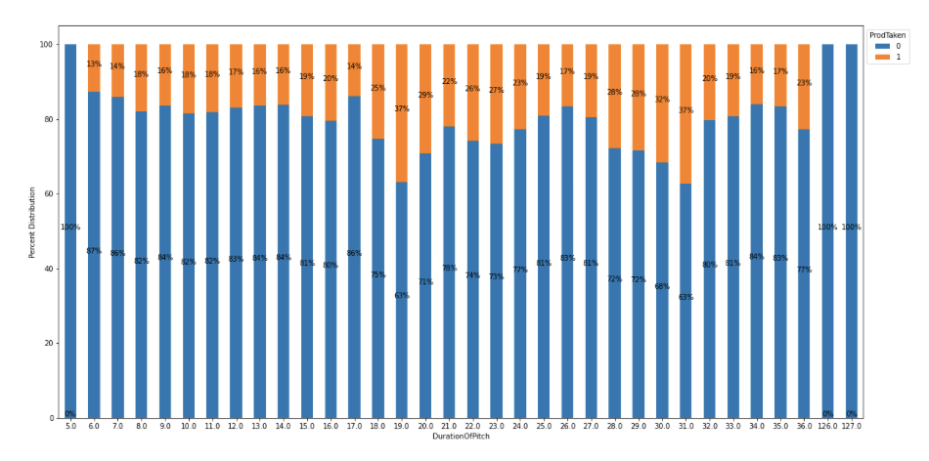
BIVARIANCE ANALYSIS
ProdTaken Vs Age
Observation
The younger demographic are interested in the new wellness package.
The middle age are at an average seem to be keying into the new package.
The newly retirement age of 58-59 years have good patronage.
ProdTaken Vs Duration of pitch
Observation
The highest number of customers who subscribed to the new travel package took between 20mins to 31mins

Slide 9
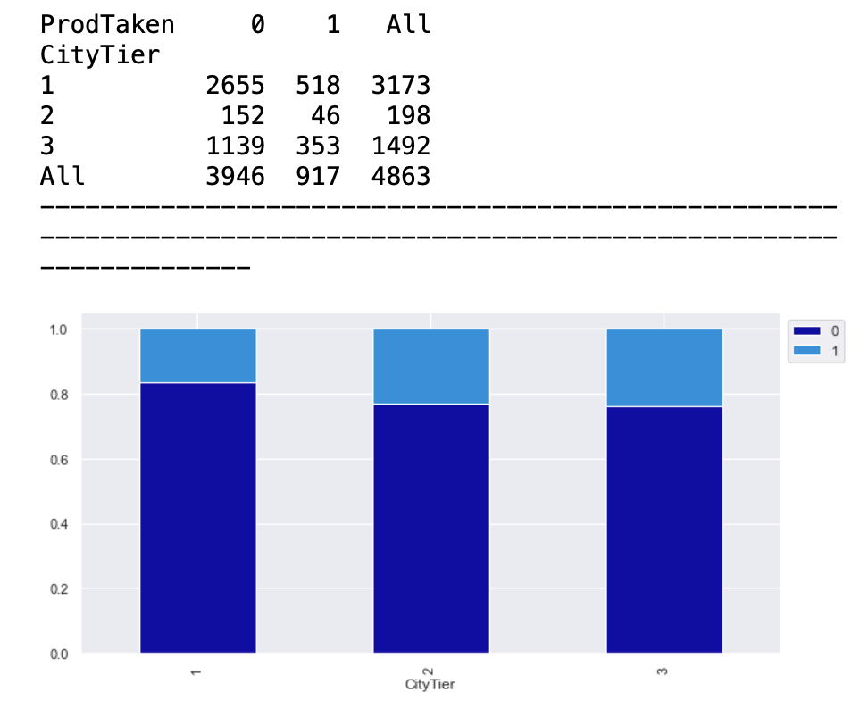
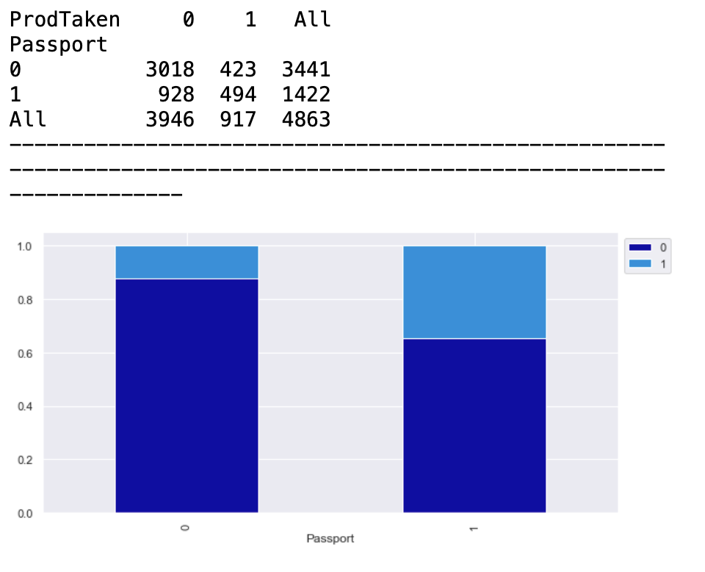
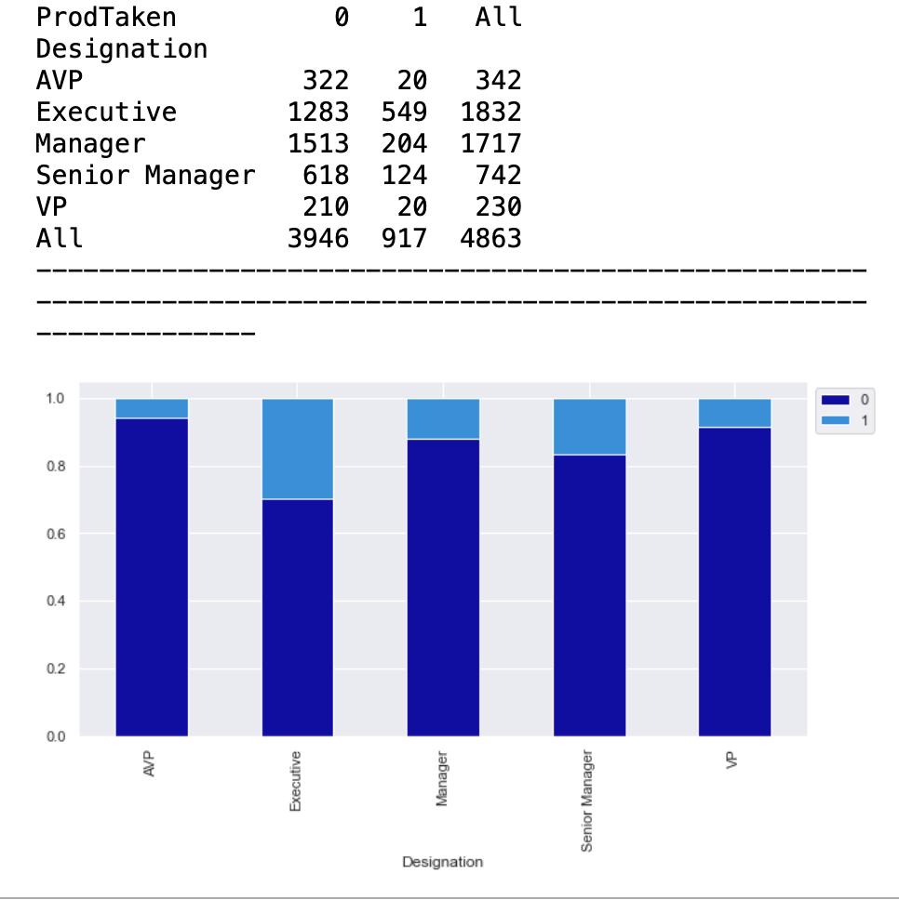
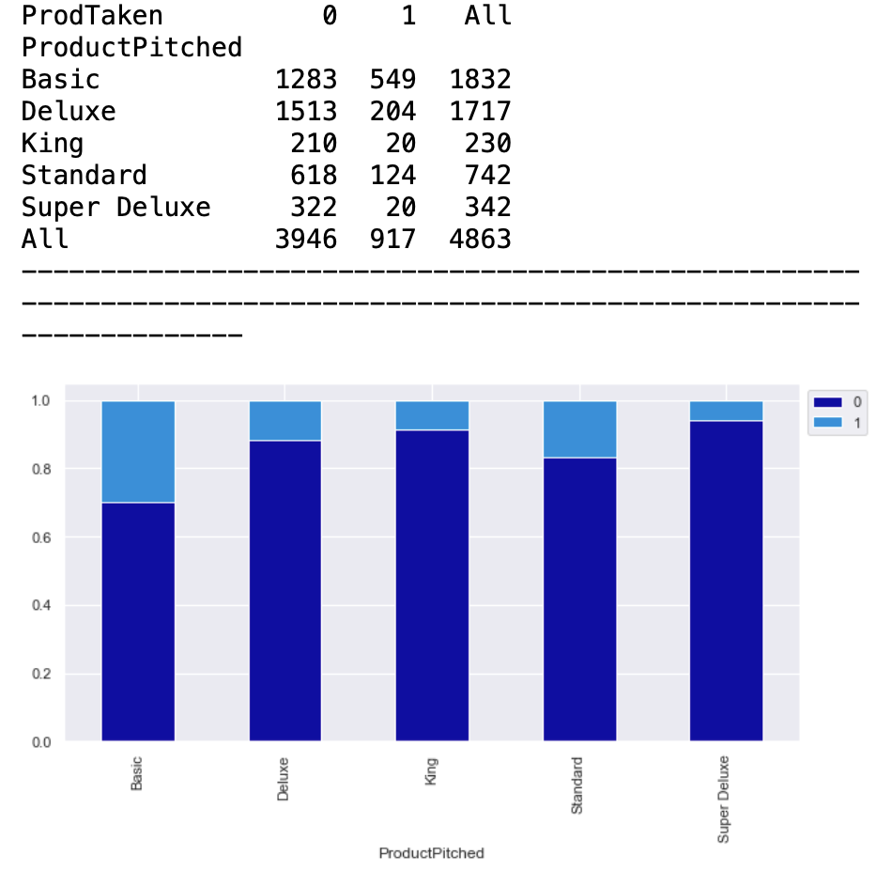
Observation
Married customer go purchased more of the wellness package.
Observation
Almost equal amount of customers who have and do not have passport subscribe to the new product
Observation
Customers who booked the basic and deluxe product purchased the new wellness product more.
Although Basic and Deluxe package are the highly purchase products
Observation
Higher rank designation executives and managers purchased the new product

Slide 10
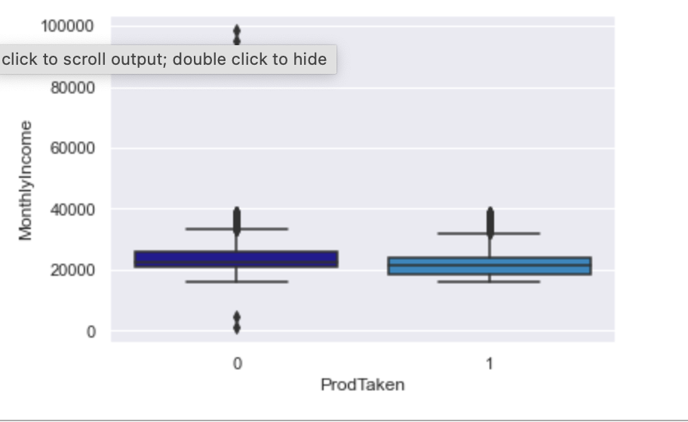
Observation
1. The average Customers who purchase the wellness package earn 21,000 and a maximum od 36,000
2. There are outliers who earn a maximum of 40,000

Slide 11
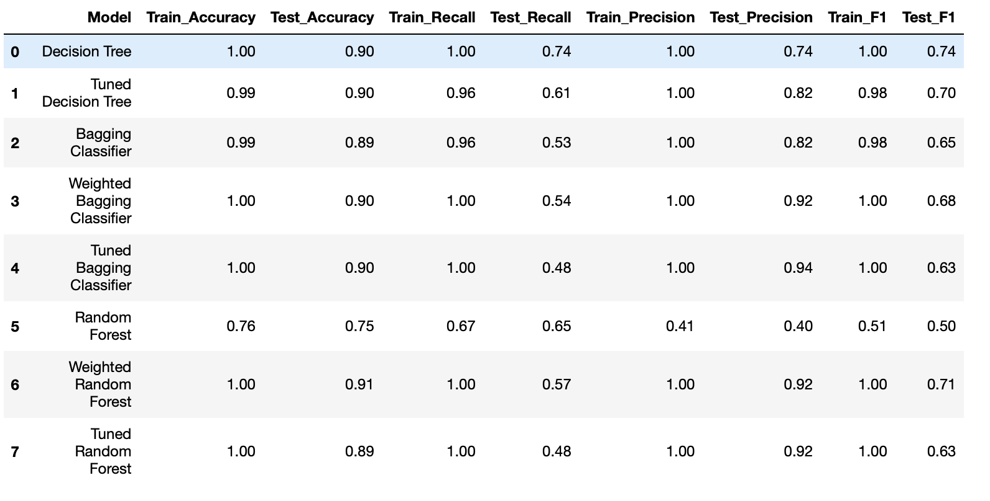
Bagging ensemble modeling
OBSERVATION:
Tuned Bagging Classifier using precision gives the highest metrics score of Train data of 1 and Test data of 0.94 with slight overfitting.
Tuned Bagging Classifier will be the best model for prediction.

Slide 12
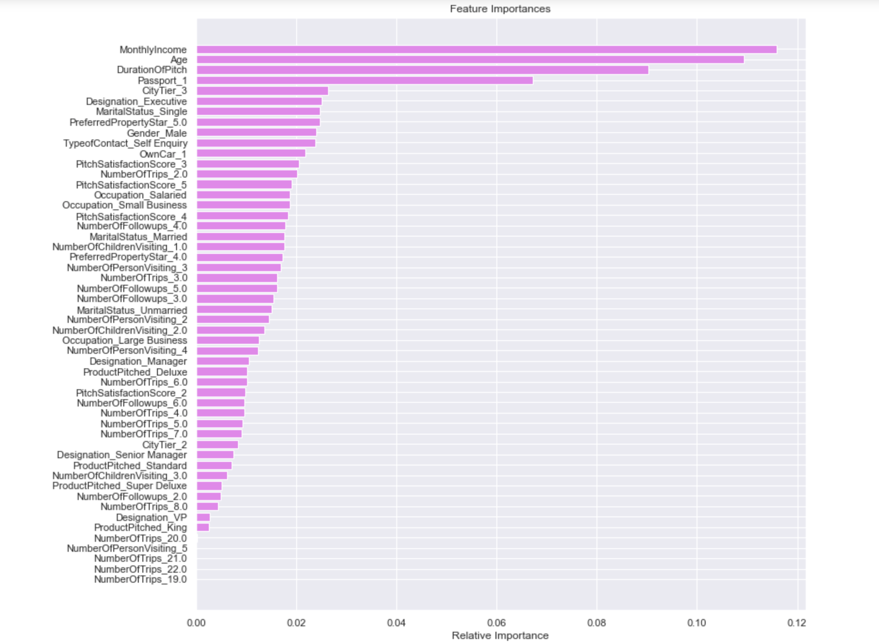
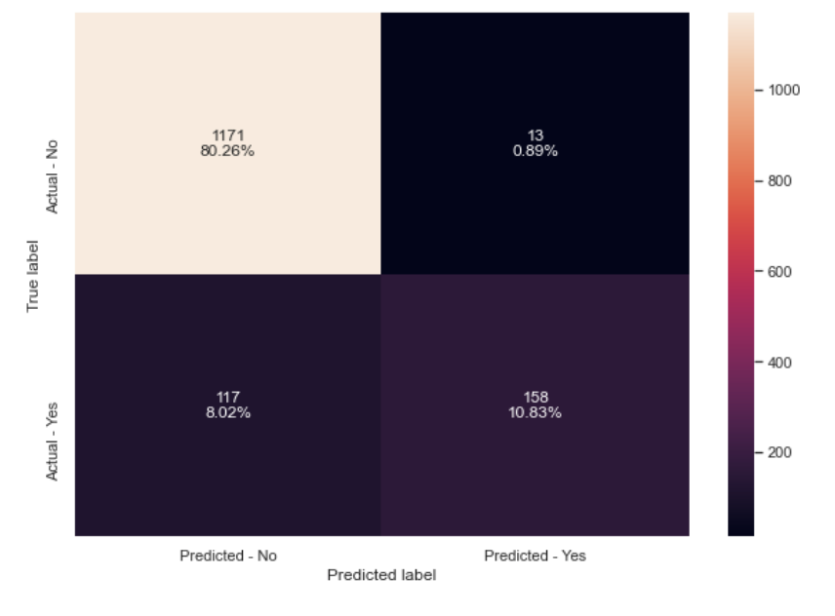
Tuned Bagging Classifier
DECISION TREE
OBSERVATION:
1. Monthly Income. Age and Duration of pitch are the 3 most important variables to target customers who will purchase the new wellness package
OBSERVATION:
1. 158 Customers have a true positive that. They will purchase the new wellness travel package

Slide 13
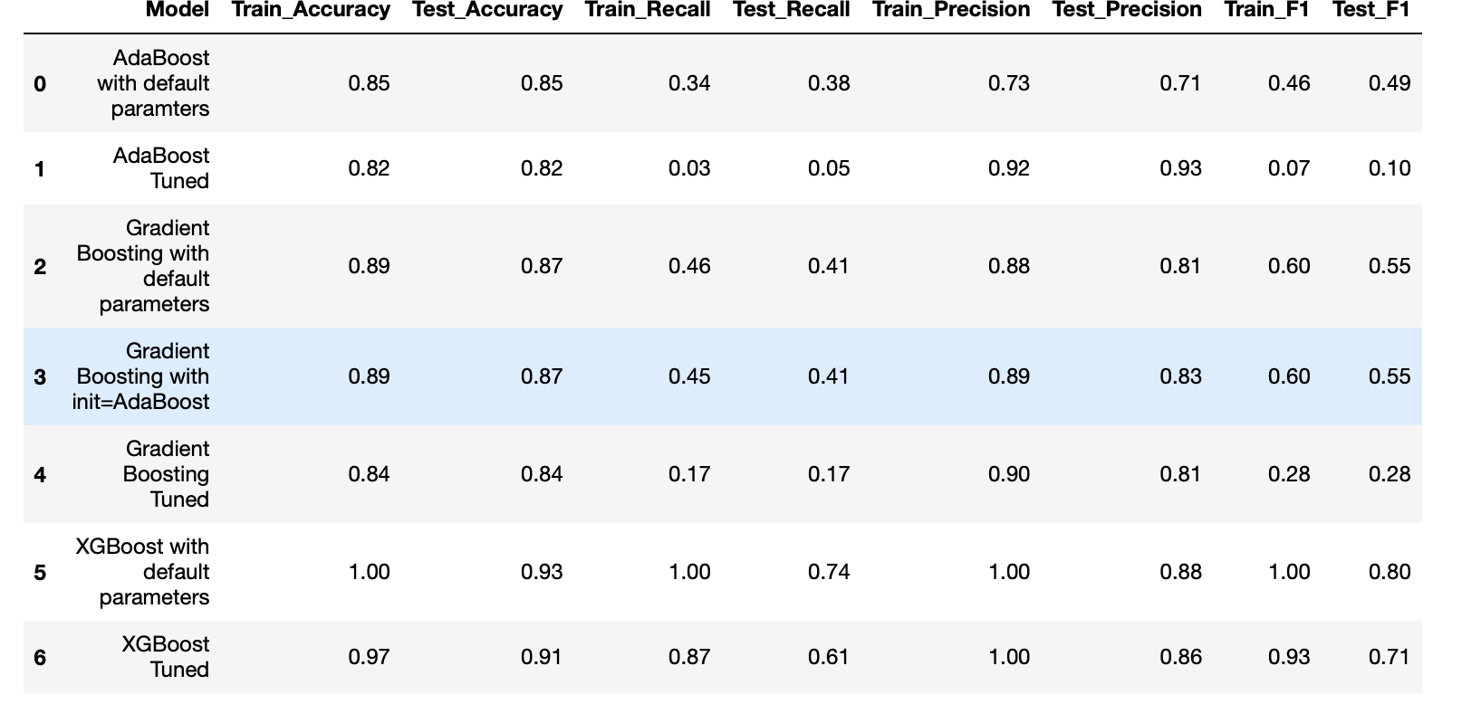
BOOSTING ENSEMBLE MODELING
OBSERVATION
XGBoosting with default parameters train accuracy is 1 and Test Accuracy is 0.93 is has the highest metrics output.
However AdaBoost Tuned will be given more priority as we want to maximize the company true positive.
Precision has a train of 0.92 and test of 0.93 this will be a better model for prediction.

Slide 14
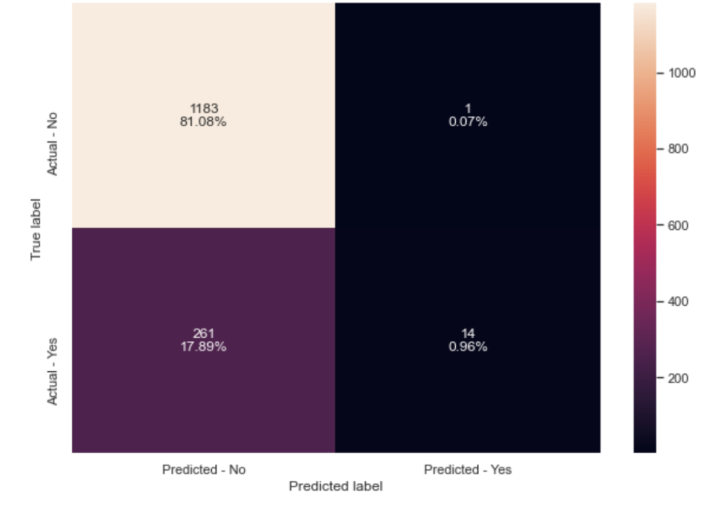
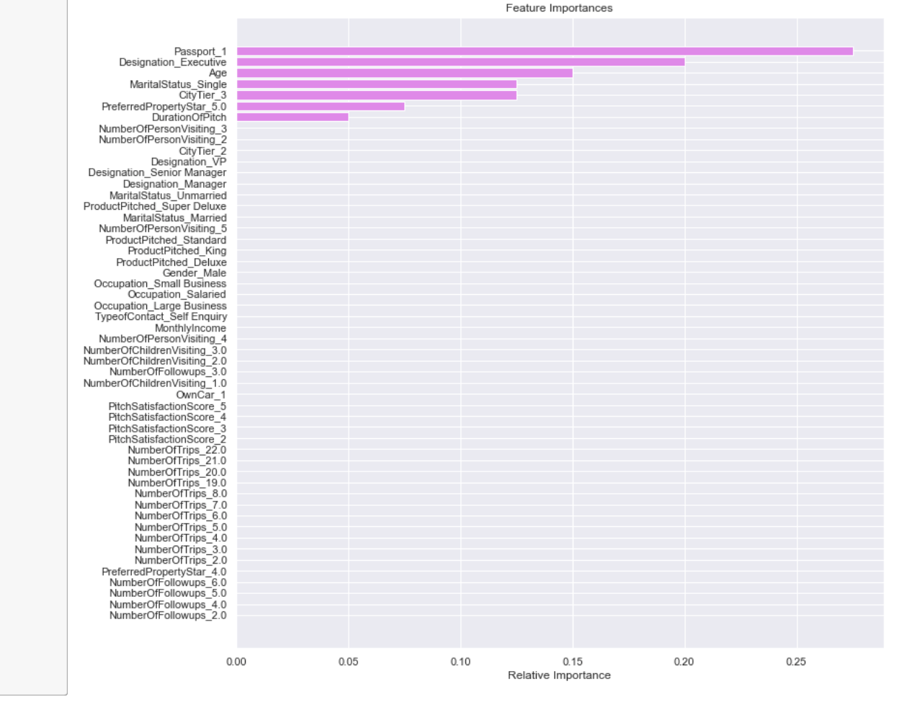
AdaBoost Tuned
DECISION TREE
OBSERVATION:
1. The True Positive came out on a low at 14 customers to purchase the new wellness package
OBSERVATION:
1. Customers who have passport is the most important variable in the variable followed by company Executive and Age

Slide 15
OBSERVATION
Tuned Bagging Classifier using precision gives the highest metrics score of Train data of 1 and Test data of 0.94 with slight overfitting.
Tuned Bagging Classifier will be the best model for prediction.
Tuned Bagging was able to predict a True Positive with precision of 158 customer to purchase the new wellness product.
Boosting technique did not do very well in building a prediction model
Monthly Income. Age and Duration of pitch are the 3 most important variables to target customers who will purchase the new wellness package
Customers with monthly income of 23,565 and above
From the bi-variance analysis between product pitch and Age the younger demographic seem to key into the wellness package more and a growing interest from age 58-59.
It take averagely 20-30 minutes for sales personnel to convince and market the wellness package to customers
Boosting Technique customers who own passport, company executive and age were important variables.

Slide 16
RECOMMENDATIONS
The sales personnel should target customers with higher income as they will be able to afford the wellness package.
The Younger demographic should continue to be a target but to expand the market the sales personnel should break into the middle age who earn above 21,000.
Its taking the sale personnel a long duration to pitch the new product. It will b e recommended to go back to the drawing table and rebrand and repackage the wellness product to be more attractive to customers within a few minutes.
Staff training should be carried out on the sales personnel to educate them on how to sale the new wellness package in a precise and convincing manner to reduce pitch duration. And target the right customers.
The affordability should still be a fact that should be looked into and target the required market that can afford it as marketing resources are limited
The wellness package should also be made available within the country for those who do not have International passport to travel.
The wellness package should be recommended for company retreats and group bonding session as organization in recent times take the physical and mental wellbeing of their employee a priority, this will drawing the necessary income and designation to purchase the new wellness package.

